Slide 1
Report on Exploratory Data Analysis (EDA) for E-retail factors for customer activation and retention study from Indian e-commerce customers
By
Satu Vinayak Pole
Intern-Flip Robo Technologies

Slide 2
Problem Statement
Various online shoppers were given a questionnaire where they filled their personal details along with some suggestions and answers related to online shopping. Then they were provided with 5 e-retail store names from which they had to choose/tick what they feel based on the question provided to them.
They were further asked which is their favourite e-store and which store would they recommend to their friends and families. This data was further compiled and provided to us to do data analysis on it and based on that provide a solution as which e-store is better and its reasons.

Slide 3
Introduction
Customer satisfaction has emerged as one of the most important factors that guarantee the success of online store. This satisfaction is dependant on 4 main factors which are as follows:
Service quality i.e how good service an online store provides to customers, for ex. query resolution, product details, seller information, etc.
System quality i.e how system performs when a customer is purchasing or browsing through online products. This also means that customers should have access to their mobile app which can be used on all kinds of devices without being crashed.
Trust ; this is the trust between e-store and customer. The customer provides his bank details, his personal name and address including email and phone number without even knowing the seller and/or e-store executives. This trust is achieved by keeping privacy of customers to themselves and not sharing it.
Net profit i.e e-stores mostly provide better discounts then retail shopkeepers making customers happy as they save lots of money. Also e-store sells almost everything so customers order online to expand their savings.

Slide 4
Exploratory Data Analysis (EDA)
Shape and duplicate entries: The shape of the dataset is 269 rows and 71 columns. From those 71 columns last column is dependant variable(label). This survey was taken from known 11 cities from all over India.
Next, the dataset was checked for duplicates and it was found that there were 166 duplicate entries; hence they were removed as they could have hampered model accuracy.
Null Values: No null values were found in whole dataset.
All the of colums have not been taken into consideration as I think that some column data is not valid for this study.

Slide 5
Analysis contd.
As seen from dataset the customers who answered the survey are mostly females than males.
It is also seen that most of the customers arrived at their now-favourite e-store using search engine and have now moved to application to purchase items as it is more convenient to access e-store via mobile devices.

Slide 6
Analysis contd.
Kind of website / application: It is further seen from seen from dataset that customer strongly agrees to have good web application/search engine support with fast loading pages. Customers also feel that e-stores should display relevant information of products alongwith complete seller information. It is also seen that customers usually take >15 min to browse and buy product but sometimes abandon the cart as they see same kind/ better alternative for cheaper price.
Payment: The website/app should have convenient payment methods as customers strongly agrees to use bank cards(debit/credit) followed by Cash On Delivery service to buy products.
Customer Privacy and Trust:The e-stores alongwith their sellers should guarantee the privacy of the customers and trust should be maintained within customers as they order products without knowing or seeing anybody.

Slide 7
Analysis contd.
Service quality: many customers strongly agrees that the e-store should be readily available to resolve queries of pre and post shopping periods with the help of different online channels ex. email, SMS, web-mail, etc. Also they should be quick/responsive to nullify the customers queries as fast as possible.
Monetary savings: Customers strongly agrees that e-stores mostly provide discounts on all kinds of products which inturn increases savings and products listed are value for money.
Return and replacement policy: Customers agrees that the e-stores alongwith their seller should have return and/or replacement policies while purchasing their products. This is because if there are any manufacturing defects or if some seller is lied in its description then the product can returned by providing new replacement.

Slide 8
Analysis on different e-stores based on customer feedback
5 e-commerce sites were used for analysis namely :
Amazon,
Flipkart,
Myntra,
Snapdeal
Paytm.

Slide 9
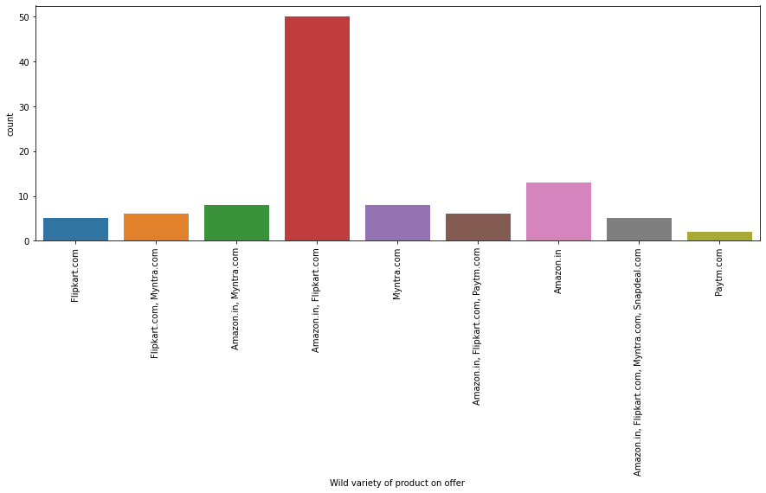
Customer’s opinion on e-sites
It can be seen that Flipkart and Amazon have wide variety of products on offer as per customers review.

Slide 10
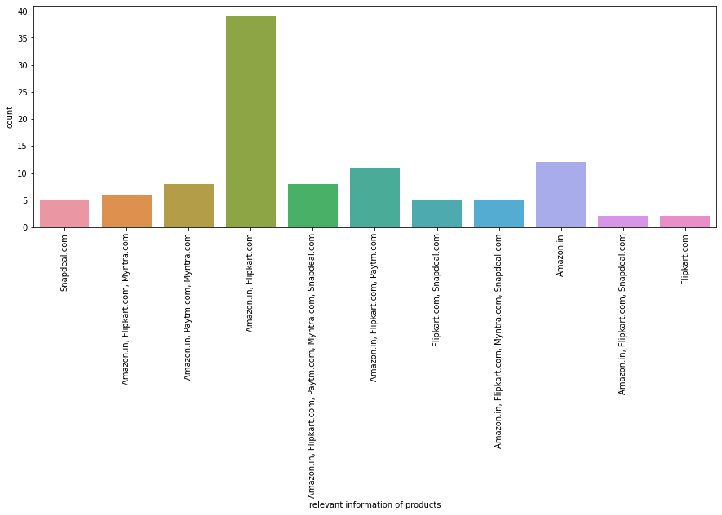
Customer’s opinion on e-sites
I can be seen from the graph that Amazon followed by Flipkart provides relevant information of products.

Slide 11
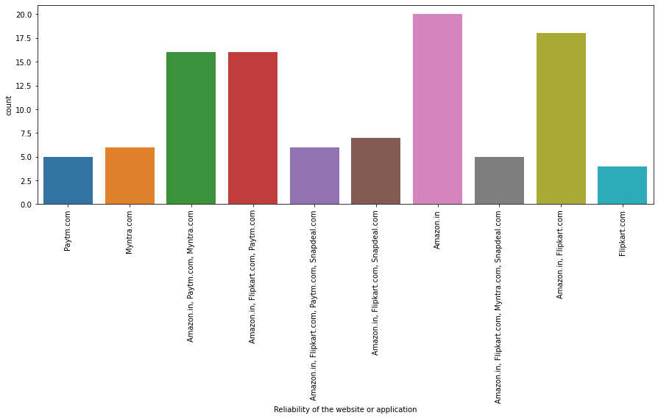
Customer’s opinion on e-sites
As seen above Amazon has the most reliable website/application followed by Flipkart and Myntra.

Slide 12
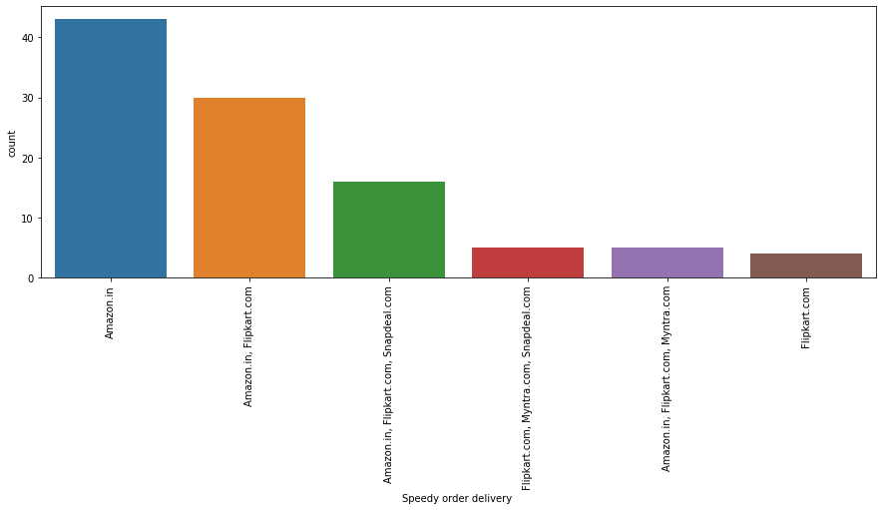
Customer’s opinion on e-sites
Most people voted for Amazon for its speedy delivery followed by Flipkart.

Slide 13
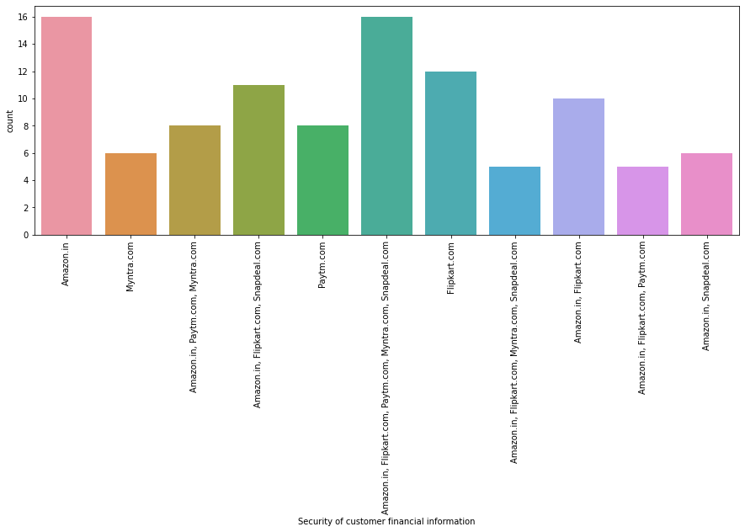
Customer’s opinion on e-sites
It is seen from above graph that Amazon is most secured to provide privacy for customers details
as well as for payment transaction followed by Flipkart and others.

Slide 14
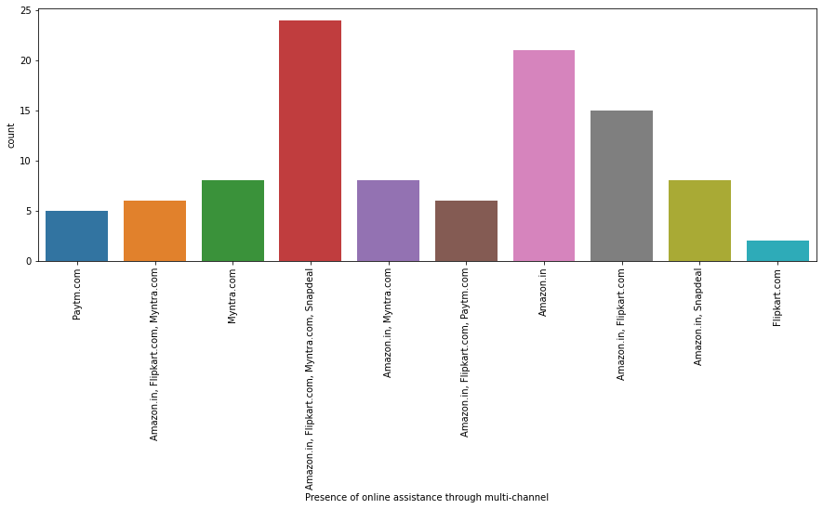
Customer’s opinion on e-sites
As seen above Amazon ranks higher then others as customers said they assisy their in many ways/channels.

Slide 15
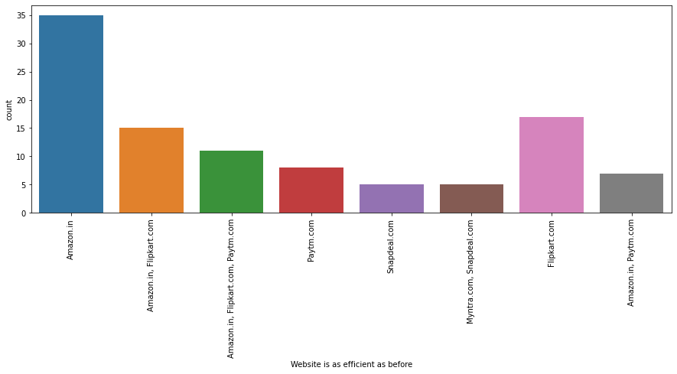
Customer’s opinion on e-sites
Most customers said that Amazon has most efficient website followed by Flipkart and others.

Slide 16
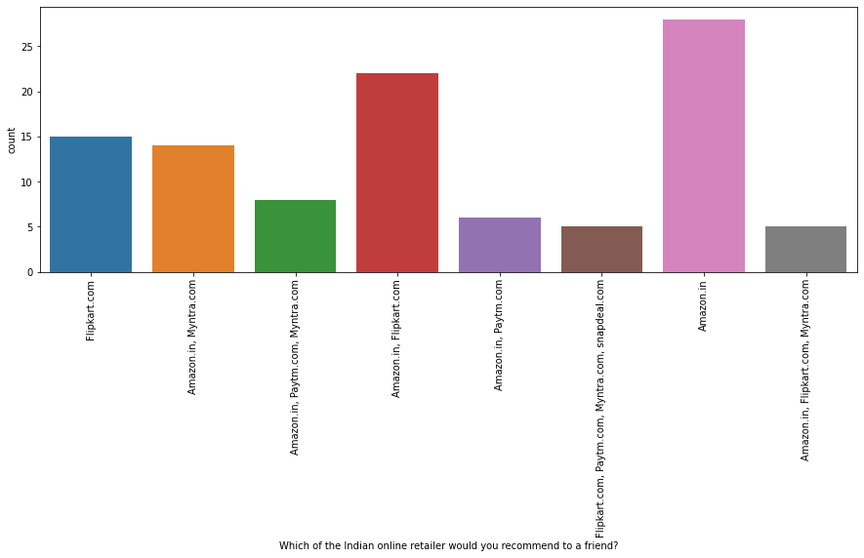
Customer’s opinion on e-sites
Looking at the plot above it seems that customers would reccommend Amazon above all, followed by
Flipkart and Myntra.

Slide 17
Conclusion
There were many factors as discussed in previous slides and seeing all the plots looks like Amazon and Flipkart are better websites to shop from as they provide good service to customers, they have good web system that does not fail much, and they are trusted by customers very well. Also they provide good discounts giving monetary benefits to customers.
Keeping these points in mind Amazon and Flipkart are better e-retail stores for customer retention and new customer activation.
Personal Verdict: If I were to reccomend any e-store website to my friend/family, I would recommend Amazon and Flipkart for all their shopping needs. Myntra can be recommended but its only fashion and/or lifestyle shopping site.

Slide 18
Thank You

